Slide 1

STOCK ANALYSIS PREDICTION
Category: AI in Finance
Subject: Advanced Machine Learning and Neural Networks
Presented By: Raghav Jindal

Slide 2
Introduction to Stock Analysis Prediction
Purpose: Harnessing machine learning to predict stock market trends.
Focus: Analyzing the stock of Apple Inc. (AAPL), a significant market player.
Aim: To explore and compare the effectiveness of various neural network architectures in predicting stock prices.
Relevance: AAPL's performance mirrors broader market trends, making it an ideal candidate for this study.
Innovation: Applying and contrasting different machine learning models to a challenging financial dataset.
Contribution: Providing insights into the capabilities and limitations of each neural network architecture in financial time series analysis.

Slide 3
DATA COLLECTION
Historical Data Span: Collected Apple Inc. (AAPL) stock prices from 1980 to 2023.
Data Source: Utilized the YFinance library to extract comprehensive financial data.
Dataset Features: Included daily opening price, closing price, high, low, and volume of stocks traded.
Significance: Over four decades of data ensure a robust foundation for analyzing long-term stock price movements.
Strategic Choice: AAPL's stock performance offers valuable insights into market trends and investor sentiment.
Analytical Depth: Extensive historical data allows for nuanced understanding of market fluctuations and stock behavior.

Slide 4
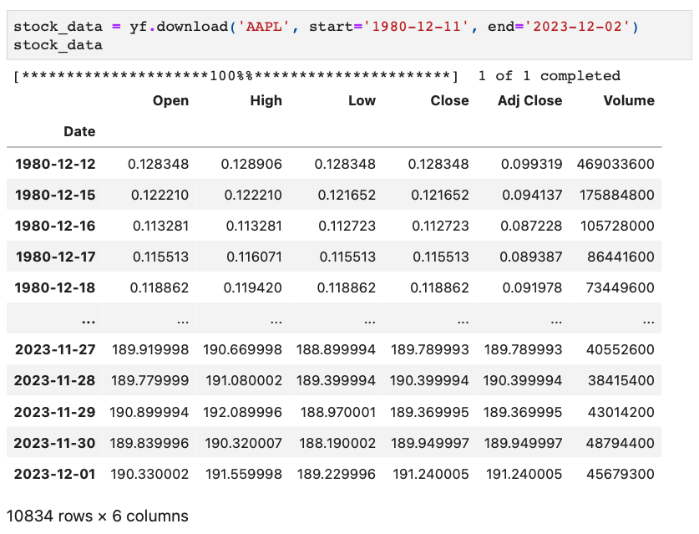

Slide 5
Building the predictive models
A. Neural Network Architecture
Long Short-Term Memory (LSTM): Specialized in capturing long-term dependencies in time-series data.
Gated Recurrent Unit (GRU): A variant of LSTM known for its efficiency and streamlined structure.
Multi-Layer Perceptron (MLP): A foundational neural network ideal for regression and classification tasks.
Convolutional Neural Network (CNN): Adapted from image processing to analyze sequential data patterns.
B. Applications and Advantages
LSTM & GRU: Suited for modeling the sequential nature and volatility of stock market prices.
MLP: Serves as a baseline to test the hypothesis of simpler architectures against complex ones.
CNN: Explores the potential of extracting complex patterns from time-series data, akin to feature identification in images.

Slide 6
Building the predictive models
C. Project Goals
To determine which model most effectively predicts stock price fluctuations.
To understand the temporal and pattern recognition capabilities of each architecture within the context of stock data.
To compare the performance of traditional neural networks against more recent and complex architectures in finance.

Slide 7
Feature engineering for enhanced predictive analysis
Objective: Enrich the dataset with derived financial indicators to better capture market dynamics.
Simple Moving Average (SMA): Utilized to smooth out price trends over a specific time frame.
Exponentially Moving Average (EMA): Gives greater weight to recent prices, providing a responsive indicator of current trends.
Price Change and Range: Captures daily stock price movements and volatility.
Log Returns: Measures continuous stock price movements, emphasizing the rate of return or loss.
Volatility: Quantifies the extent of stock price fluctuations, indicating the inherent risk level.
Relative Strength Index (RSI): Gauges momentum by identifying overbought or oversold conditions.
On Balance Volume (OBV): Correlates volume flow with stock price changes, indicating potential price movements.
Bollinger Bands: Assesses market volatility and identifies potential breakouts.
Typical Price and Weighted Close: Offers alternative perspectives on a stock's closing price behavior.
Conclusion: These engineered features aim to provide the models with a multifaceted view of the stock market, enhancing the predictive capabilities.

Slide 8
Optimizing input features for prediction
Implemented feature selection to identify the most predictive indicators for stock price movement.
Correlation Analysis: Evaluated the linear relationship between features and stock prices.
Principal Component Analysis (PCA): Transformed correlated features into a set of linearly uncorrelated components.
Random Forest Regressor (RFR): Assessed feature importance based on contribution to model accuracy.
Lasso CV (Least Absolute Shrinkage and Selection Operator with Cross-Validation): Applied regularization to highlight significant features while reducing overfitting.
Recursive Feature Elimination (RFE): Iteratively refined the feature set to retain only the most impactful predictors.
Mutual Information: Captured non-linear dependencies between features and stock prices.
Conclusion: These methods streamlined the feature set, reducing dimensionality and enhancing the models' focus on relevant predictors.

Slide 9
Model refinement
A. Process of Retraining
Adjusted models to work with a refined feature set for improved relevancy.
Focused on recalibrating internal weights and biases to align with new inputs.
B. Evaluation of Refined Models
Assessed models post-retraining using key performance metrics.
Metrics used: Mean Absolute Error (MAE), Mean Squared Error (MSE), Root Mean Square Error (RMSE), R-Squared (R2) Score.
C. Expected Outcomes
Anticipated enhanced predictive accuracy due to more targeted training.
Aimed to reduce overfitting by eliminating noise and less relevant features.

Slide 10
Results and evaluation
A. Key Evaluation Metrics
Mean Absolute Error (MAE): Measures the average magnitude of errors in predictions.
Mean Squared Error (MSE): Quantifies the average of the squares of the prediction errors.
Root Mean Square Error (RMSE): Provides the square root of MSE for more interpretable error scale.
R-Squared (R2) Score: Indicates the proportion of the variance in the dependent variable predictable from the independent variables.
B. Analysis of Model Performance
Evaluated each model's accuracy in stock price prediction using the above metrics.
Compared how each model's performance improved with the refined feature set.

Slide 11
Results and evaluation
C. Insights from the Evaluation
Identified models that most effectively captured the variance in stock prices.
Analyzed whether the feature reduction techniques contributed to a decrease in prediction errors.
D. Conclusion
The evaluation phase provided critical feedback on the effectiveness of the feature engineering and model refinement processes.
These insights are essential for guiding future improvements and establishing robust methods for financial market prediction.

Slide 12
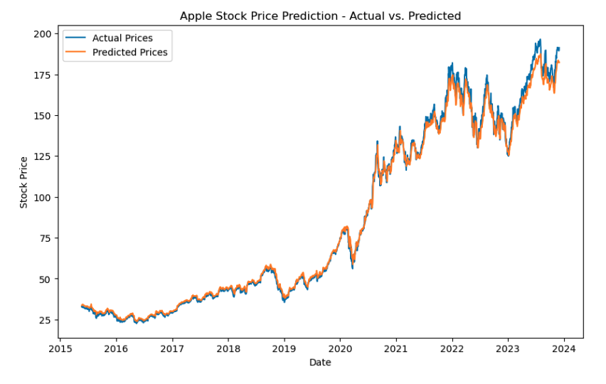

Slide 13
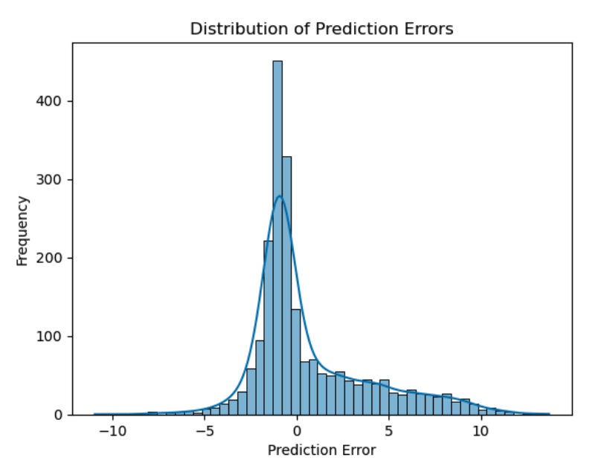

Slide 14
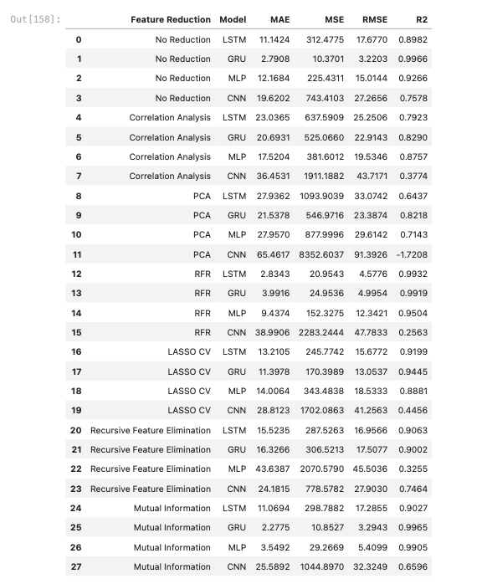
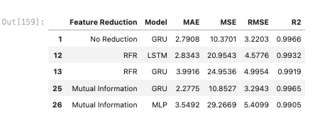
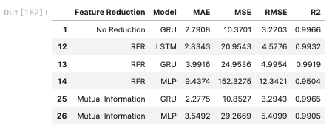

Slide 15
Discussion and analysis
A. Impact of Future Selection Techniques
Analyzed the varying effects of feature reduction methods like PCA and RFR across different models.
Observed notable improvements in LSTM and MLP models with certain feature selection strategies.
Identified the varying effectiveness of techniques, highlighting the need for model-specific feature optimization.
B. Model Performance Insights
GRU and LSTM models showed high efficacy in capturing stock price dynamics with refined features.
MLP model demonstrated significant performance enhancement with Mutual Information.
CNN model's adaptation to financial time-series data provided unique insights into pattern recognition capabilities.

Slide 16
Discussion and analysis
C. Future Model Interdependency
Revealed the importance of tailored feature selection for each neural network architecture.
Highlighted how different models respond distinctively to the same set of features.
D. Conclusion
The study underscores the complexity of feature-model interplay in stock price prediction.
These findings contribute to a deeper understanding of applying neural networks in financial market analysis.

Slide 17
Challenges and limitations
A. Data Quality and Preprocessing Challenges
Ensuring data accuracy and completeness for over 40 years of stock information.
Implementing techniques to handle missing values, outliers, and data normalization.
B. Overcoming Overfitting
Balancing model complexity with generalizability to prevent learning noise and fluctuations.
Utilizing dropout, regularization, and cross-validation to mitigate overfitting risks.
C. Model Selection and Complexity
Challenges in choosing the optimal model architecture for the dataset's high dimensionality.
Navigating trade-offs between model accuracy and computational efficiency.

Slide 18
Challenges and limitations
D. Reliance on Historical Data
Recognizing the limitations of using historical stock data to predict future market trends.
Addressing the unpredictability of the stock market and external market-shaping events.
E. Conclusion
These challenges highlight the intricacies and complexities involved in financial modeling using AI.
Learning from these challenges is essential for advancing the field of AI in finance.

Slide 19
Conclusion and future work
A. Key Findings
Demonstrated the effectiveness of neural network models in predicting AAPL stock prices.
Highlighted the importance of feature engineering and selection in enhancing model performance.
Revealed the differential impact of various neural network architectures on financial time series analysis.
B. Key Findings
Understanding the complexity of financial datasets and the need for meticulous data preprocessing.
Recognizing the challenge of model selection and the balance between complexity and accuracy.

Slide 20
Conclusion and future work
C. Future Research Directions
Integrating ARIMA with neural networks to address forecast stagnation and enhance adaptiveness.
Exploring hybrid models and advanced neural network architectures for improved predictions.
Expanding data sources to include real-time data, economic indicators, and global market trends.
Investigating transfer learning for application across various financial instruments.
D. Conclusion
This project lays a foundational step towards sophisticated AI applications in stock market analysis.
Continued refinement and exploration in this field promise to unlock more accurate and efficient financial forecasting tools.

Slide 21
YouTube URL’s
3 Minute Video - https://youtu.be/Ao5izxCJhR0
15 Minute Video - https://youtu.be/RP9aTaBKoLg

